Slide 3
NOVEMBER 4TH AGENDA
Devotion: Jason Suhr
2020 in Review: Mart Green
BT Progress: Todd Peterson
What Must Change: Geof Morin
Radical Interdependence: CEO Panel
1
2
3
4
5

Slide 4
All questions regarding access to the ETEN Summit should be directed to melissa@missionmutual.org.
A Few Housekeeping Notes
We will conduct Q&A following each speaker so use @speakerfirstname in Chat to appropriately direct questions.
Unanswered questions will be addressed after the Summit and answers provided online.
Things to remember …
No need to memorize or take screen shots of presentations; all will be available online following the Summit.

Slide 5
MART
GREEN
The 6 O’s of COVID

Slide 6
THE 6 O’S OF COVID
Oblivious
01
Overwhelmed
02
Overcomer
03
Onward
04
Overachieve
05
One
06

Slide 7
Q&A

Slide 8
TODD
PETERSON
2020 BT Progress

Slide 9
ALL ACCESS GOALS
95%
of the world’s population will have access to a full Bible.
Every man, woman and child on earth has access to God’s Word and its life-changing hope by 2033.
of the world’s population will have access to a New Testament.
99.96%
100%
of the world’s population will have access to at least some portion of the Scripture.
2
full Bible translations will be available in the world’s most strategic 100 written languages.

Slide 10
In 2020,
127
LANGUAGES
ALL ACCESS GOALS
Did You Know?
were either engaged for the first time or reached an All-Access Goal in translation.

Slide 11
COMPLETE BIBLE TRANSLATION
700
th

Slide 12
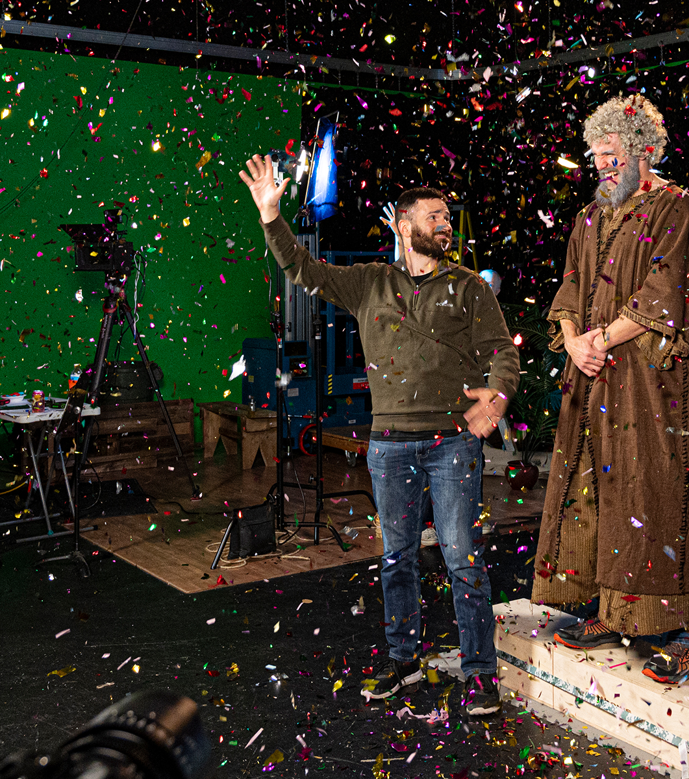
HISTORIC ACCOMPLISHMENT - ASLV
A Complete Bible for Deaf People
38 years in the making
Translated by Deaf people, for Deaf people
Features 53 different translators
Paves the way for other translation work in other sign languages. The ASLV will be used as a resource text for other Bible translations – more than 350 different sign languages exist around the world.

Slide 13
ILLUMINATIONS GLOBAL

Slide 14
Q&A

Slide 15
GEOF
MORIN
“What Must Change” Initiative

Slide 16
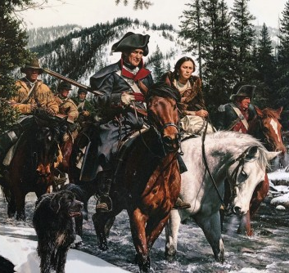
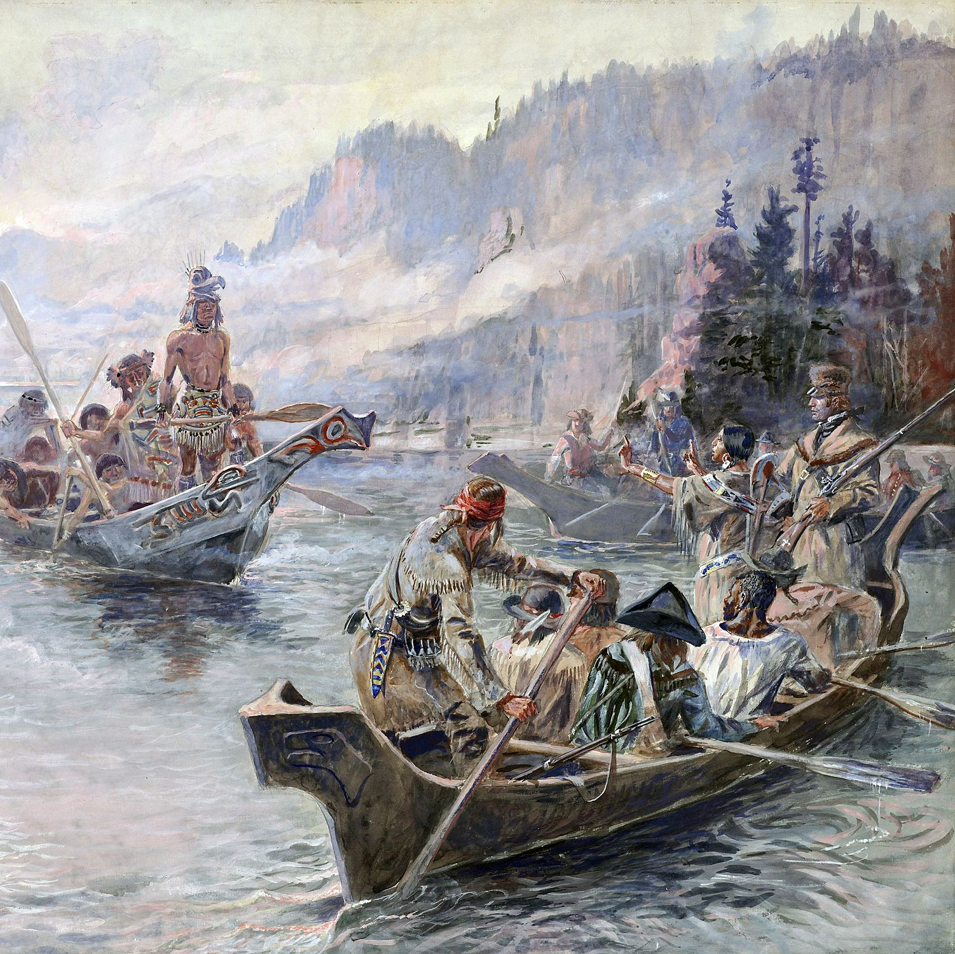
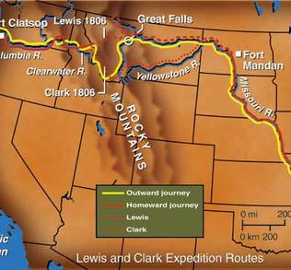
CHALLENGE
“Reaching the Continental Divide”

Slide 17
WHAT MUST CHANGE INITIATIVE
Comprehensive Change Initiative to identify and activate the accelerants needed to reach ETEN’s 2033 goals.
March
2020
April
2020
May
2020
TODAY
First ETEN Steering Committee Whiteboard Conversations
Chartering of the What Must Change Subcommittee
Recommendations Clarified & Activation Groups Deployed
Advancing of the Top 10 Action Items

Slide 18
10 ACTION ITEMS
Board Engagement
Peer Accountability
Prayer Movement
Quality Assurance
Sign Language Platform
Box 3 Initiatives
BOLSTER UNITY
INTEGRATE INNOVATION
ETEN Tables
Church-based Networks Partnership
Map All-Access Goals
Prioritize Large Language Projects
BROADEN INVOLVEMENT
ALIGN ENERGIES

Slide 19
#2: Board Engagement
Dedicated Resource Tools
Models for Board Communication
First Activations
#3: Prayer Movement
ETEN Prayer Manual
Mass Market Prayer Campaign
ETEN Working Groups are progressing first deliverables for Action Items.
#4: ETEN Tables
Growth from collaborative explorations
Deaf Ministries affinity table
#9 and #10: Map All Access Gaps
Locking the List
Activating Multilingualism learning

Slide 20
ACTION ITEMS #6 & #8
ECOSYSTEM
ETEN Innovation Lab
TRANSLATION
ETEN OPERATING ENGINE

Slide 21
Q&A

